Slide 1
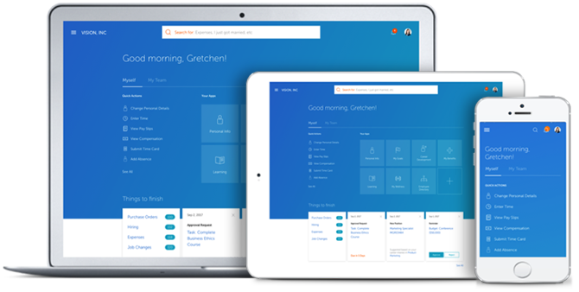
HCM Cloud
Absence Management
For Employees with More Than One Job
Welcome to the Step-by-Step Tutorial for Submitting a Time Off Request!

Slide 2
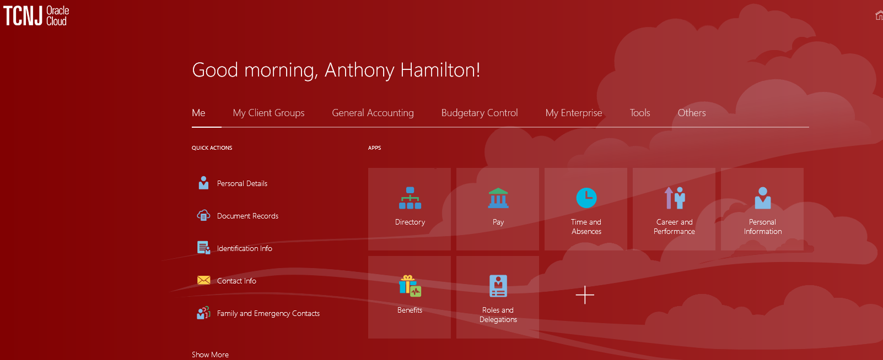
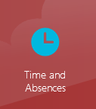
Welcome to Anthony Hamilton’s Cloud Account.
You should see that the “Me” option is underscored. Click the Tile.

Slide 3
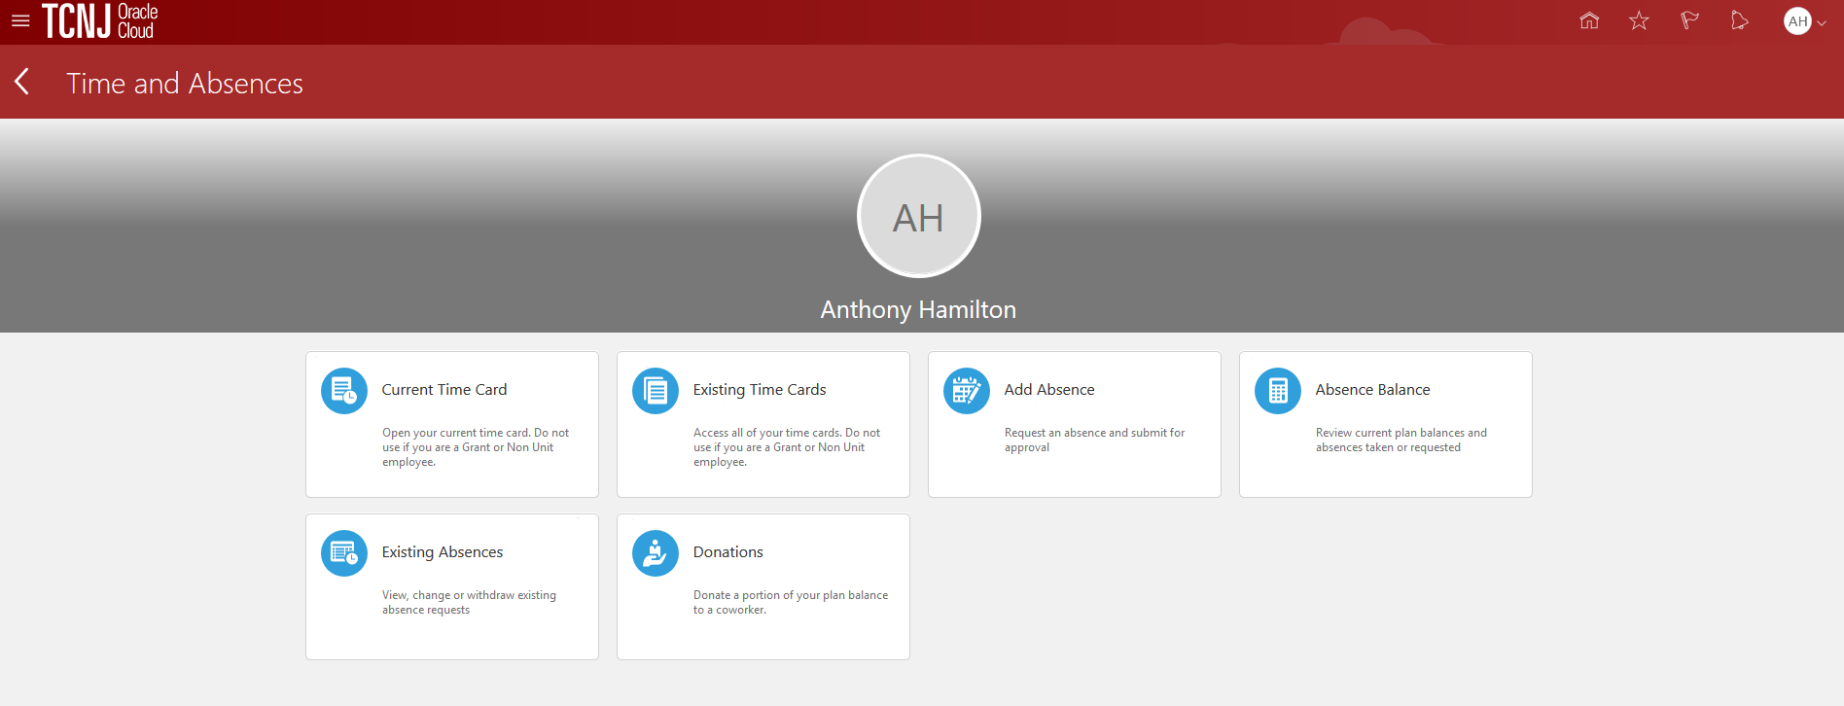
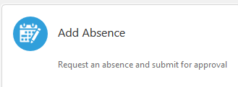
To add an absence, click the Tile.

Slide 4
Click the down arrow and a drop down box appears. For this demonstration, we select the Sick option. Once the Sick option is selected, cloud automatically opens to the next screen.

Slide 5
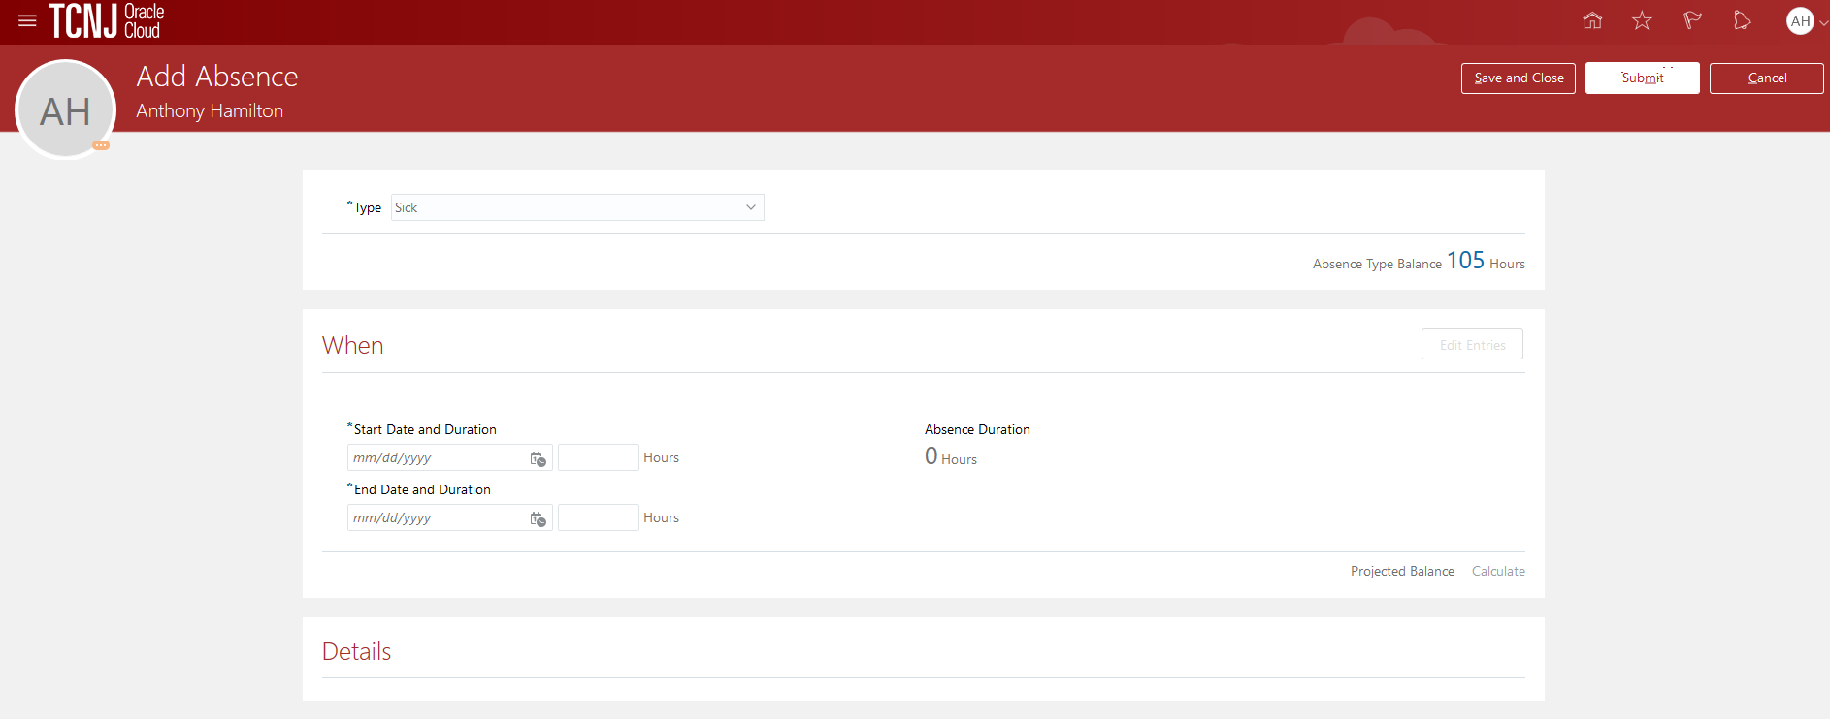
Click the Edit Entries box. The next screen will appear.

Slide 6
Click the Add box. The details for your absence will appear.

Slide 7
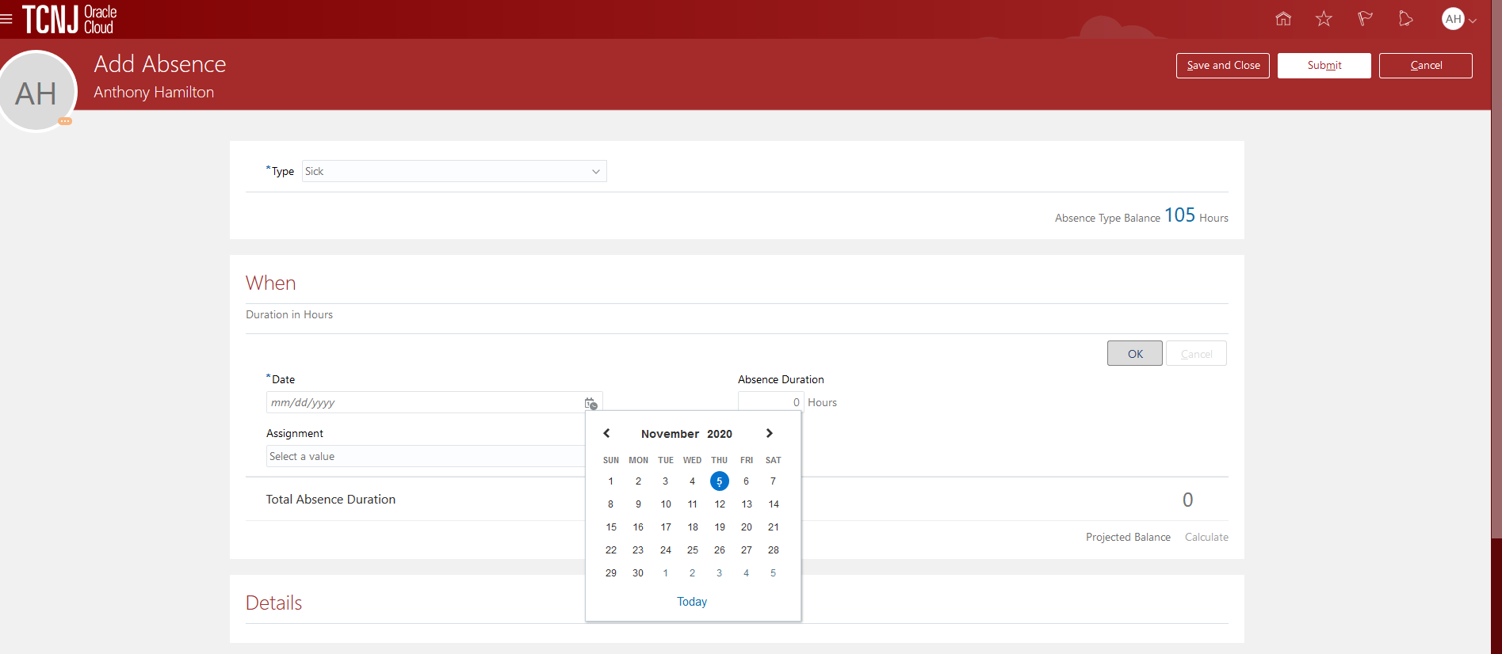
Click the calendar icon and a calendar will appear. Click on the start date for your absence request. Once you select the start date, the screen will auto-populate. The next slide of the presentation depicts the fields that will appear on the screen.

Slide 8
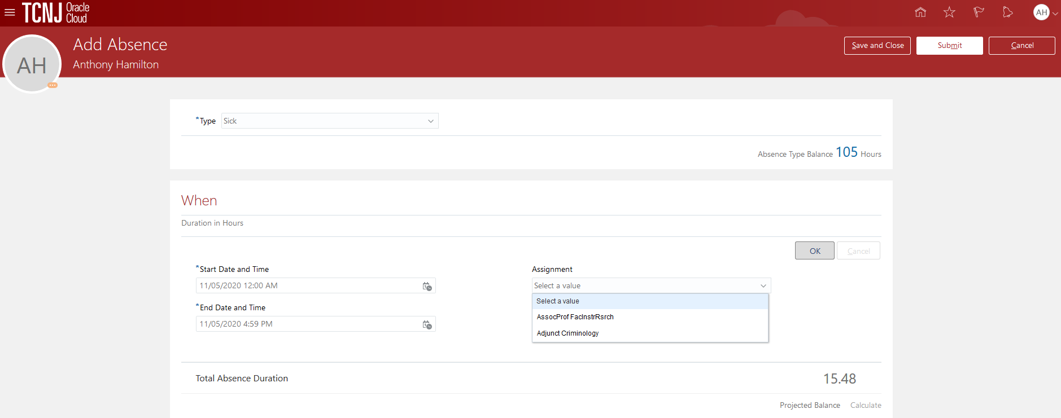
The start date will be populated. But also note that the total absence duration is more than the hours in your work day. At this point, click the drop down arrow beside “select a value”. This may be found under the word, Assignment. Now select your regular job from the drop down menu. Anthony is an associate professor and also has an adjunct faculty role.
Anthony’s benefits are tied to his associate professor position. Once the associate professor position is selected, Cloud will automatically recalculate the number of hours associated with the absence request.

Slide 9
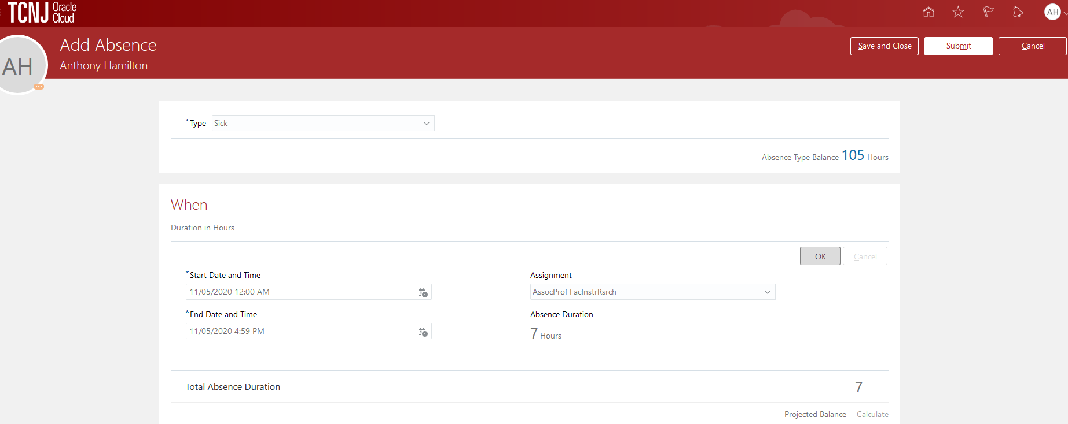
Here we see that the hours are recalculated. Now, click on OK.

Slide 10
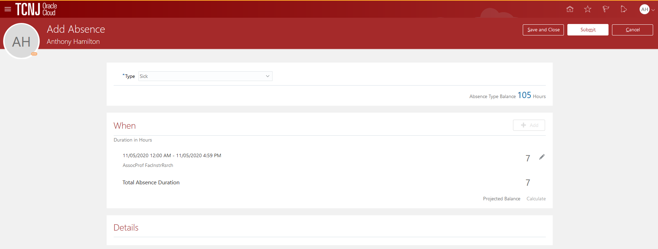
This is the screen that will appear. Note that the absence is for one day based upon the associate professor position.
Press submit.

Slide 11
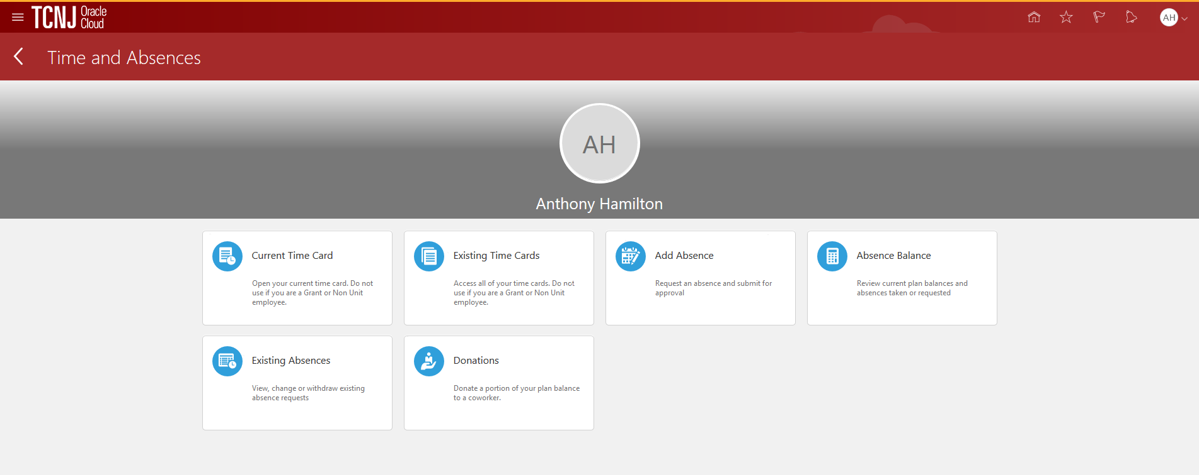
Once the absence request is submitted, cloud takes you back to the first absence screen.

Slide 12
We have come to the end of this presentation.
Please contact us at:
HCM Cloud Response Team
Thank you!

